Slide 1
Wi-Find

Slide 2
Purpose
Have you ever been away from home and needed an internet connection? Wi-Find allows the user to have instant Wi-Fi access, while allowing the host to make some extra money on the side.
Wi-Find is a platform in which allows the users to check their vicinity for Wi-Fi hosts and then connect to the hosts’ Wi-Fi for the period of time that they paid for.
Uses: Business Emergencies, Family Emergencies, Gaming, consuming content

Slide 3



Tech Platforms
Language: Dart
Dart is an Open-Source, client-side programming language developed by google
Framework: Flutter
Flutter is an Open-Source UI SDK developed by Google. It allows the development of iOS/Android apps and uses Dart as the programming language.
Database: Google Firebase
Firebase is a set of hosting services for any type of application.

Slide 4
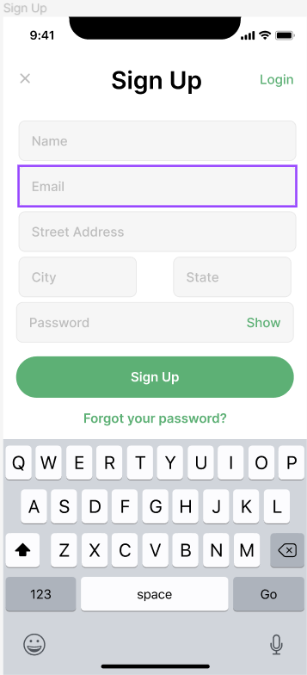
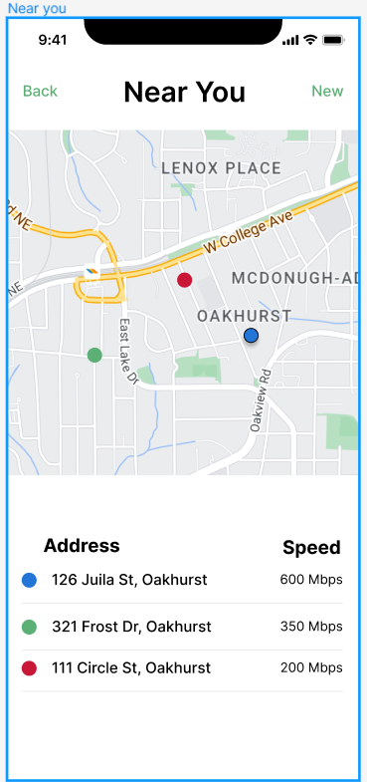
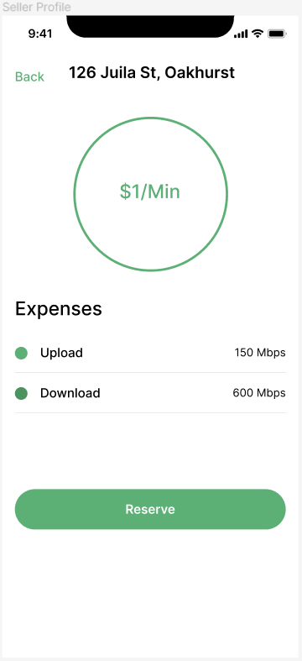
Mock-up

Slide 5
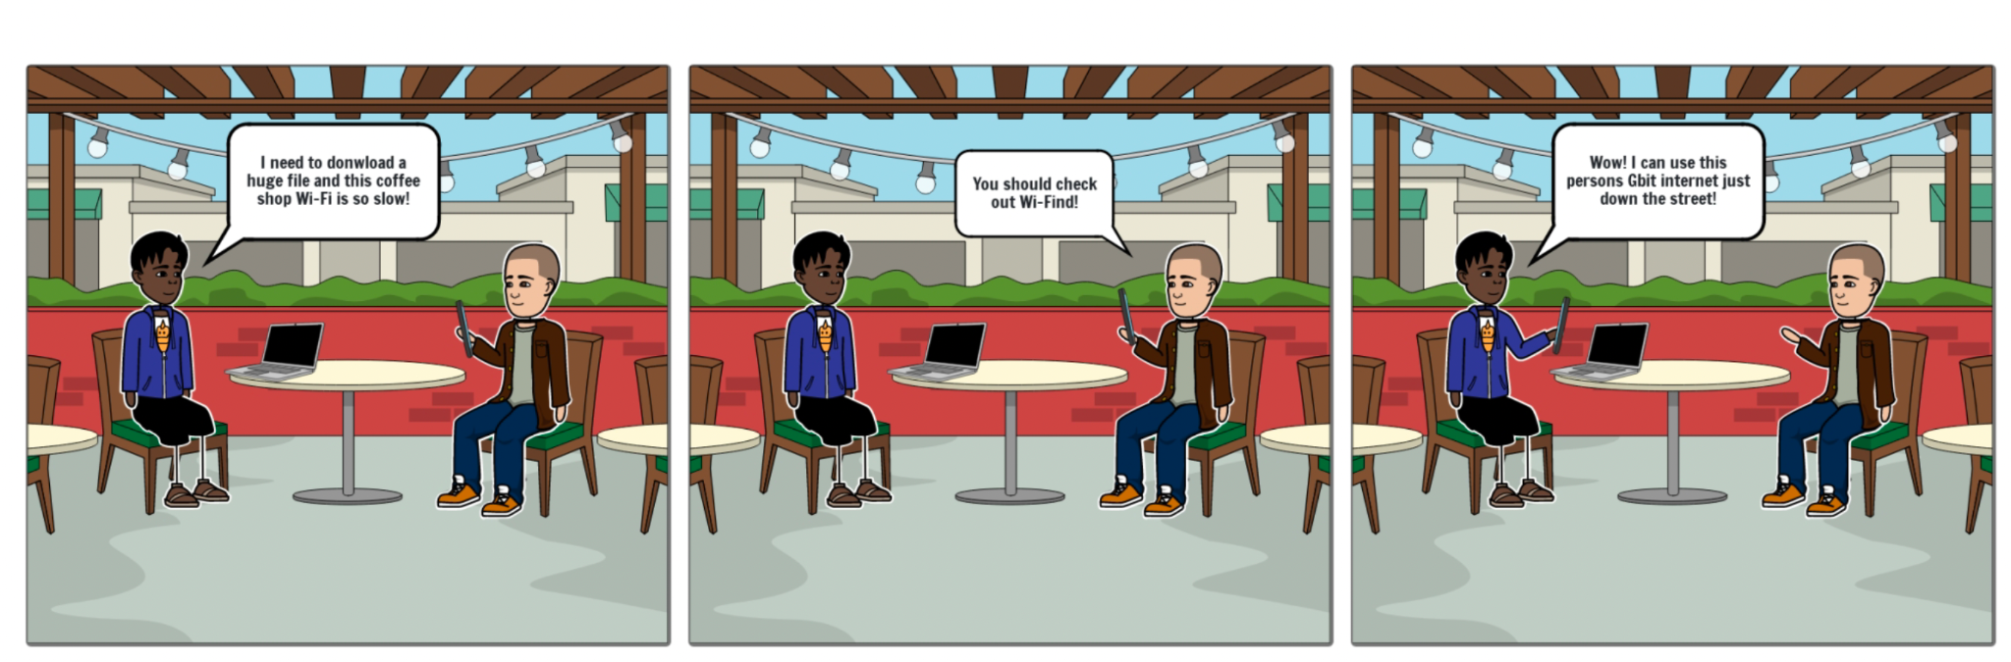
Storyboard 1

Slide 6
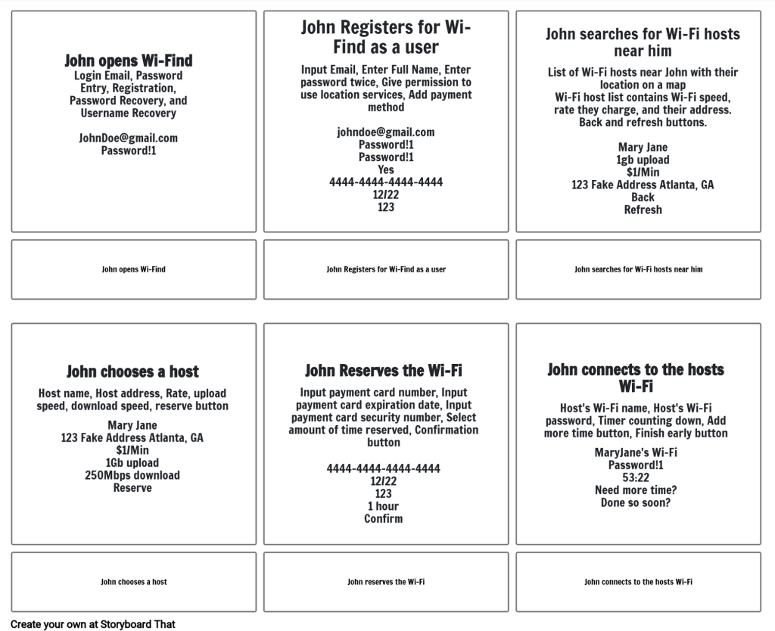
Storyboard 2

